Slide 1
Mobile/Wireless RDMA CAAP, Cluster As Application Platform
Opens new realm, beyond Internet
Run distributed apps on the cluster, not PAAS (Platform As A Service), but native, CAAP
New protocol-free networking schemes
Yitzhak Bar Geva, Prof. Jon Crowcroft Sept. 2015

Slide 2
Introduction
Wireless Device Clusters
Overview of RDMA and RoCE
The RDMA model mapped over Wireless
InfiniBand
RoCE, Soft-RoCE
iWARP, Soft-iWARP
OFED, ULPs - Upper Layer Protocols
Programmability with verbs
Freedom from Protocols
Upcomming RDMA Technologies
Use Cases
Implementation and Challenges
Resources
Contents

Slide 3
Up Front Notes
Some basic familiarity with InfiniBand and RDMA is assumed. Tutorials on the Internet. See resources
With a concerted effort by an academic/industrial consortium, this vision can become realized in time for 5G Cellular

Slide 4
Introduction
D2D in 5G cellular can turn mobile/wireless device clusters into the next generation application platform.
Development of distributed apps over on-the-fly clusters is rapidly gaining popularity, but today’s networking strata is sorely lacking for the job.
The widely used RDMA clustering model with verbs programming has been a standard in HPC data centers for decades. RDMA on mobile clusters is ideal for writing distributed applications with their own custom protocol-free networking schemes.

Slide 5
5G standards must take a close look at RDMA networking, particularly D2D to avoid IP lockin.
RDMA is faster, more efficient. Zero-copy and lower cpu usage in the (extremely slim) RDMA network stack are more important in the mobile environment.
Furthermore, it lends naturally to clustering, user programmable networking.
5G Standards

Slide 6
Computing Platform Evolution
Each Wave Dwarfs its Predecessor
Today’s networks and clouds are remotely provided services, like computing once was

Slide 7
Following the Analogy…
Device Clusters open a vastly wider Application Space with an order of magnitude more clusters than devices
Pooled Mobile Device Clusters

Slide 8
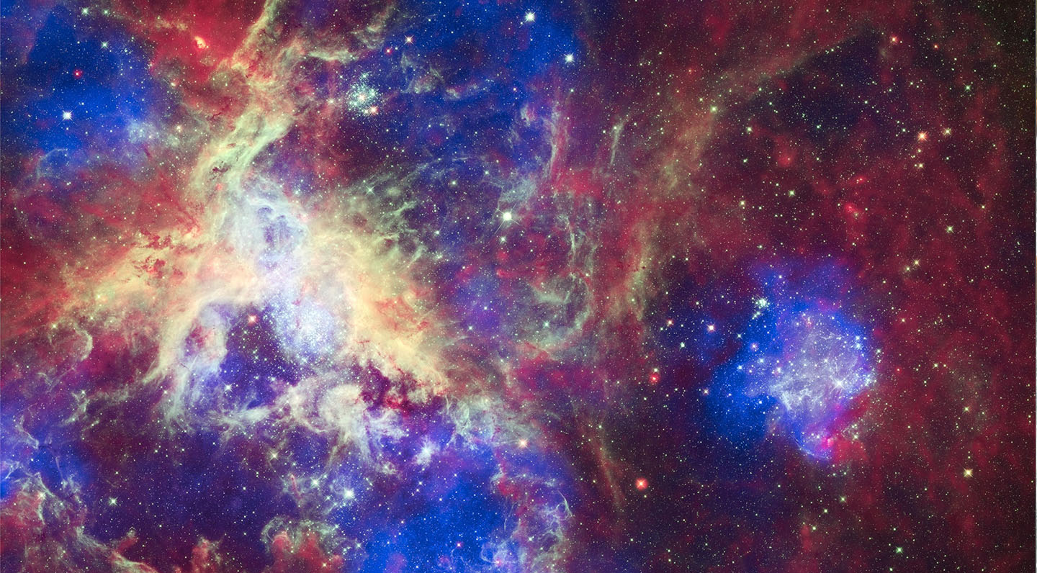
See Pooled Device Clusters as Powerful Application Platforms
App
App
App
App
App
App

Slide 9
For illustration, imagine if computing had not evolved outward from a monolithic core but from
personal computers
with only close-proximity wireless communications,
performance necessitated clustering of nearby machines,
that conformance was unheard-of and
gave rise to a myriad of Open Source clustering schemes

Slide 10
Powerful over and beyond sheer horsepower
The RDMA cluster model today is limited to High Power Computing, which like networking, is beyond the reach of most developers and users.
User-programmable RDMA can potentially realize an untold number of new messaging and distributed programming paradigms.
See Wireless RDMA first and foremost as a people-power revolution whose impact can be grasped by likening it to the PC revolution which:
    Made computing resources universally accessible and
    Opened programming, the legacy of a select few, to the world.
    The PC’s feeble processing power was no issue over time as has been the case with the smartphone as well.

Slide 11
Advantages
HPC apps run unchanged
Write distributed apps in popular languages
Devices pool their cores and storage
Devices can belong to multiple clusters and the Internet
New networking paradigms by RDMA verbs programming.
Dynamic reconfiguration. Configuration can be volatile, according to optimization requirements, devices popping in and out. See volley ball slides.

Slide 12
A cooperative distributed programming platform in an era of friendly concurrent programming languages
Networking and clouds in‑hand, no longer externally supplied services
Freely configurable, dynamically reconfigurable IOT‑type pooled‑device clouds, on a common platform

Slide 13
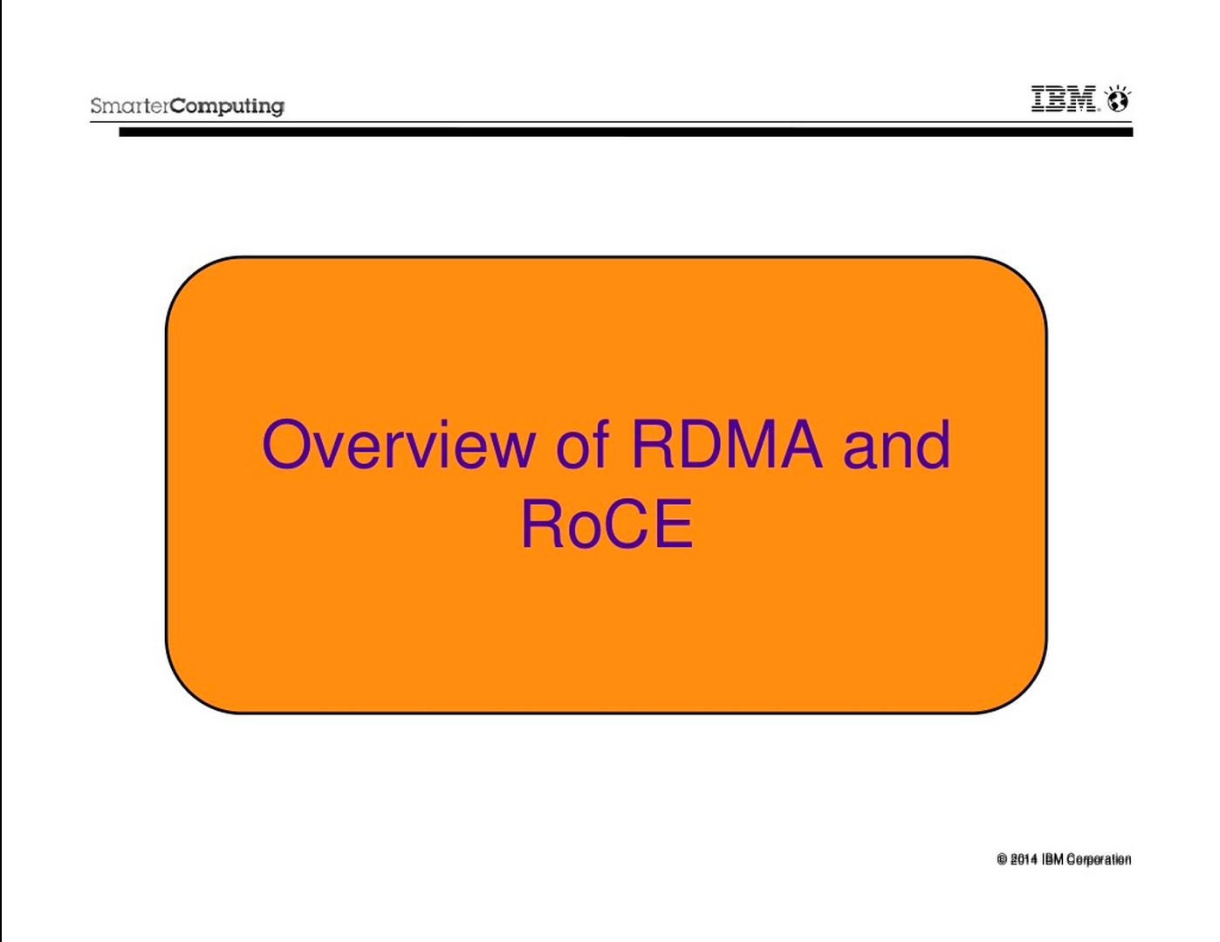

Slide 14
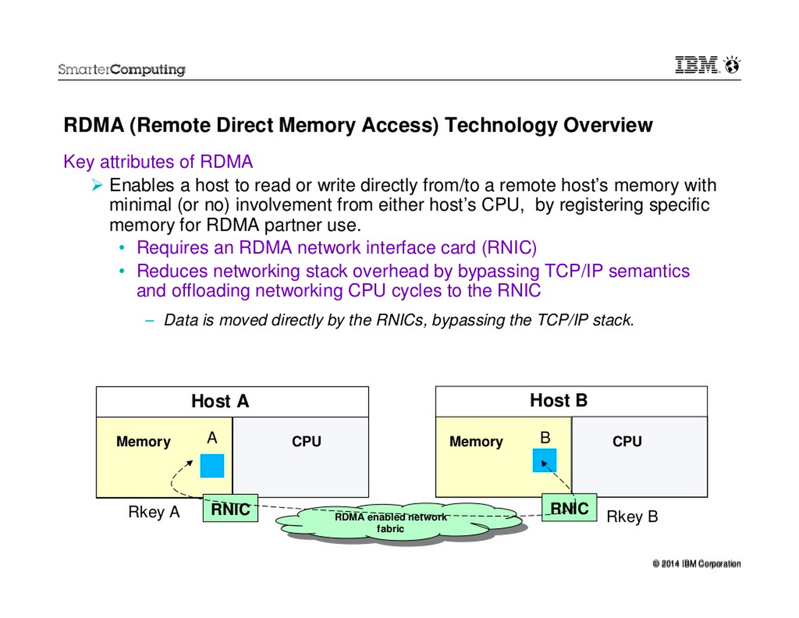

Slide 15
Remote Direct Memory Access
Remote
  data transfers between nodes in a network
Direct
  no Operating System Kernel involvement in transfers
  everything about a transfer offloaded onto Interface Card
Memory
  transfers between user space application virtual memory
  no extra copying or buffering
Access
  send, receive, read, write, atomic operations

Slide 16
RDMA Benefits
High throughput
Low latency
High messaging rate
Low CPU utilization
Low memory bus contention
Message boundaries preserved
Asynchronous operation

Slide 17
RDMA Technologies
InfiniBand – (41.8% of top 500 supercomputers)
  SDR 4x – 8 Gbps
  DDR 4x – 16 Gbps
  QDR 4x – 32 Gbps
  FDR 4x – 54 Gbps
iWarp – internet Wide Area RDMA Protocol
  10 Gbps
RoCE – RDMA over Converged Ethernet
  10 Gbps
  40 Gbps

Slide 18
RDMA Architecture Layering
User Application
OFA Verbs API
OSI
Layers
RDMAP
DDP
Transport
MPA
IB Transport API
TCP
IB Transport
Network
IP
IB Network
Data Link
Ethernet MAC & LLC
IB Link
Physical
Ethernet PHY
IB PHY
CA
IWARP “RNIC”
RoCE “NIC”
InfiniBand “HCA”
Notes:
Note: InfiniBand transport in h/w (on the NIC)

Slide 19
RDMA Model Flexibility
Multi-Instance.
    Membership in a cluster is seen as a single instance in the device
Multi-Cluster
    Device may be member of multiple clusters simultaneously
Multi-App
    Cluster itself may be multi-instance, multi-process
Flexible message‑passing network schemes
    RDMA verbs (or newer, MPI optimized PSM) facilitate user‑programmable, protocol-free NIC behavior

Slide 20
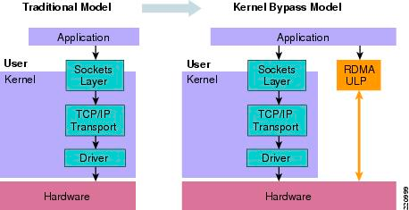
Kernel Bypass

Slide 21
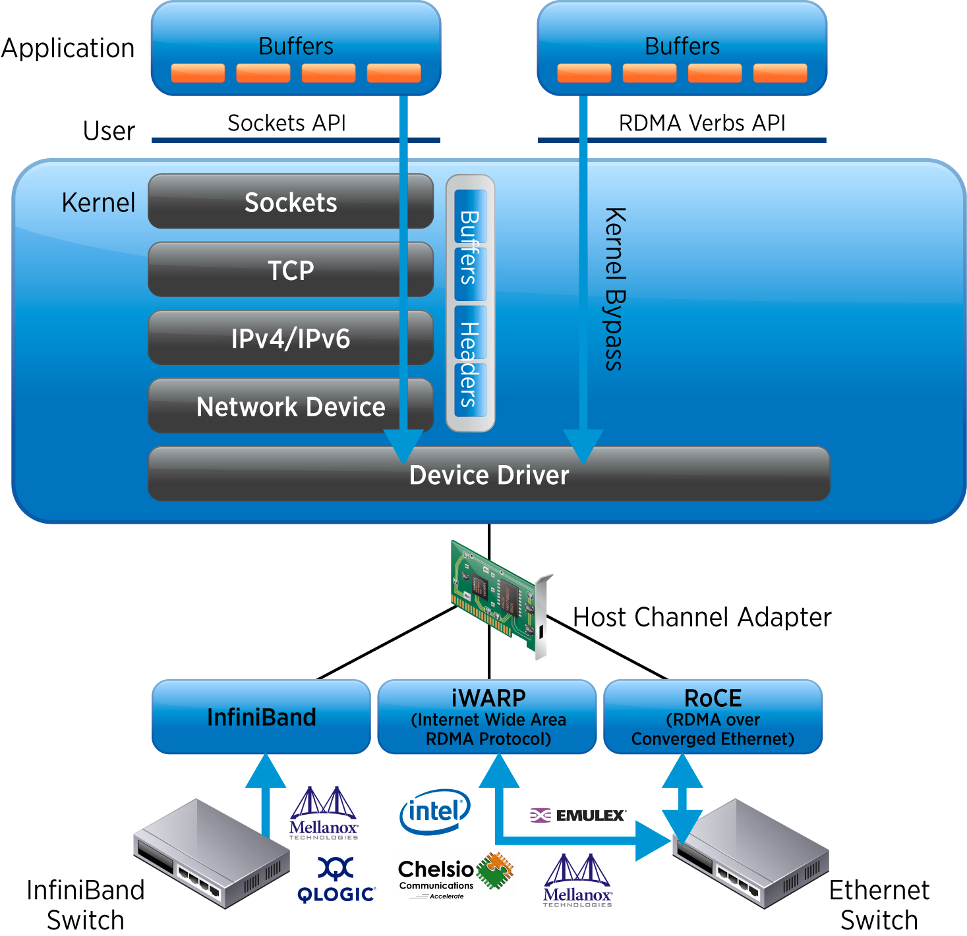
RDMA
User Space programmable

Slide 22
If only we had an InfiniBand wireless chip…

Slide 23

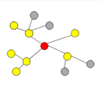
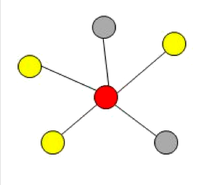
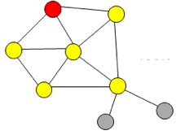
RDMA Mapped Over Wireless
Wireless Channel Adapter
Mobile Clusters

Slide 24
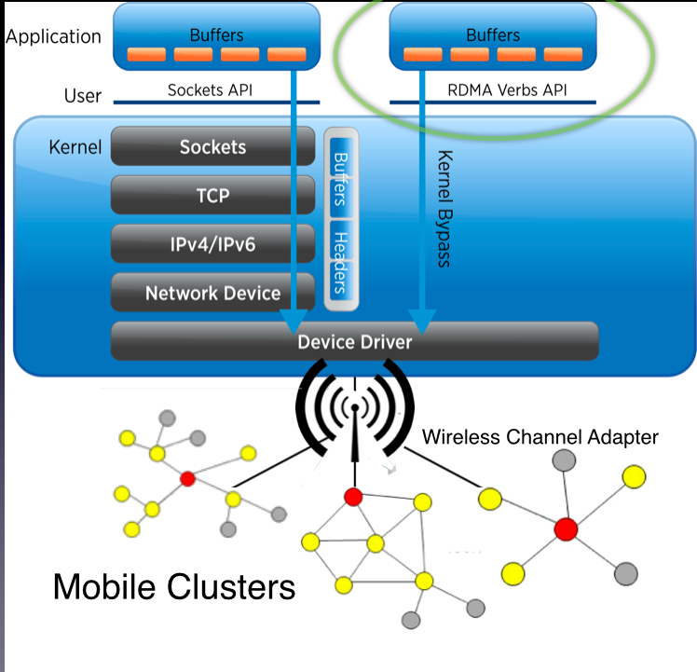
RDMA
Mapped Over Wireless Cluster

Slide 25
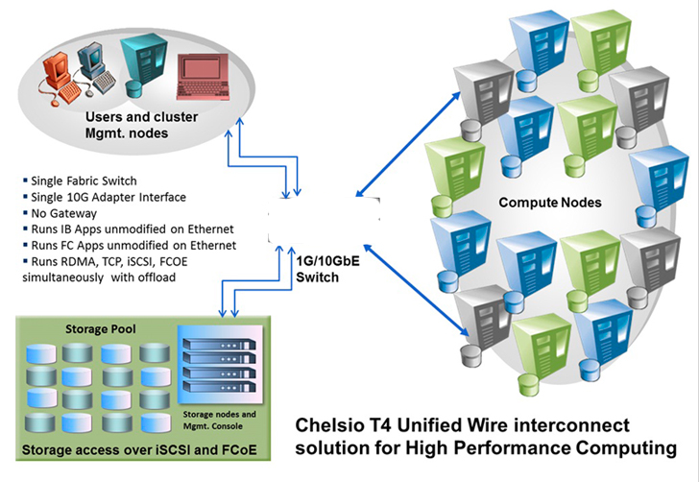
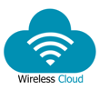
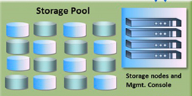
Becomes Wireless HPC
where these are mobile devices

Slide 26
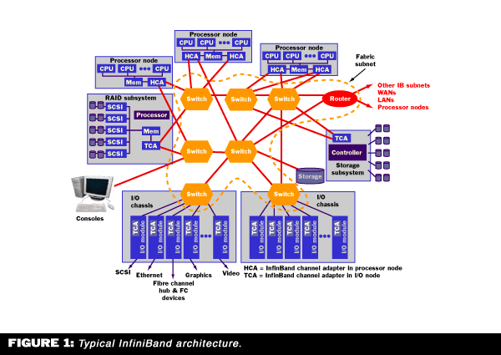
InfiniBand
Notes:
High speed communications link for data flow between processors and I/O devices with support for up to 64,000 addressable devices. Scalable, supports quality of service (QoS) and failover. Widely used as a server connect in HPC environments. InfiniBand is at the core of this presentation. Familiarity with IB is assumed.

Slide 27
InfiniBand
Notes:
InfiBand is evolving, becoming more efficient, utilizing hardware advancements

Slide 28
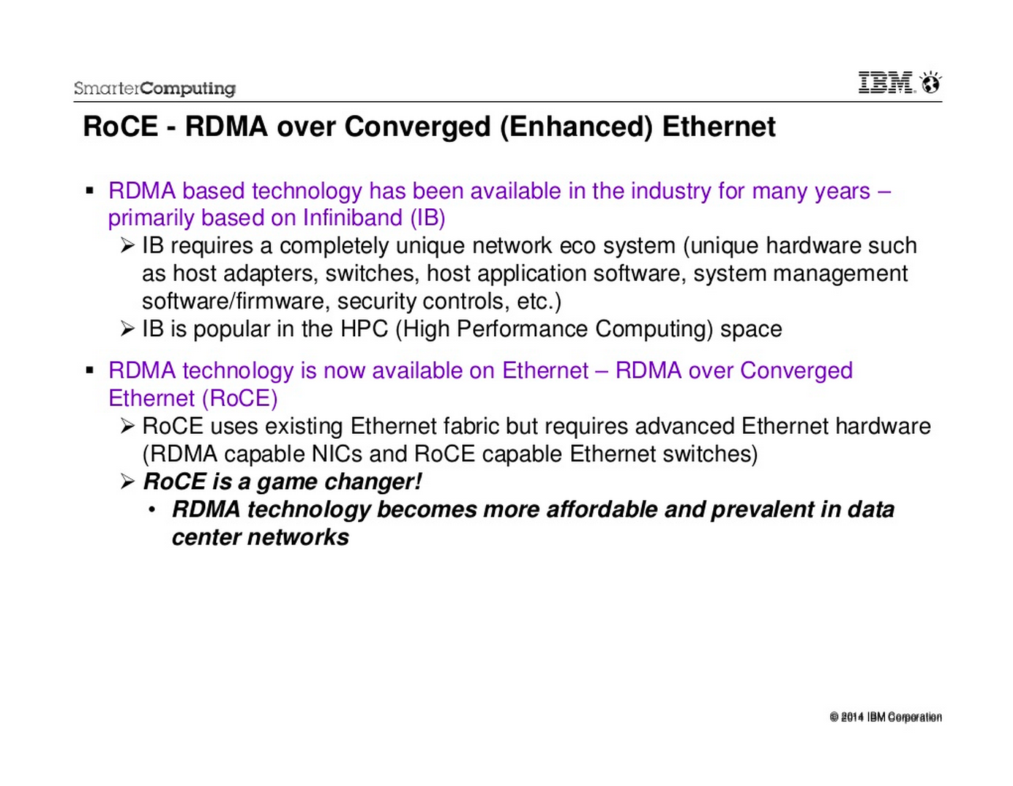
RoCE useful in our humble opinion only in the interim. InfiniBand over wireless is the prime choice

Slide 29
ROCE

Slide 30
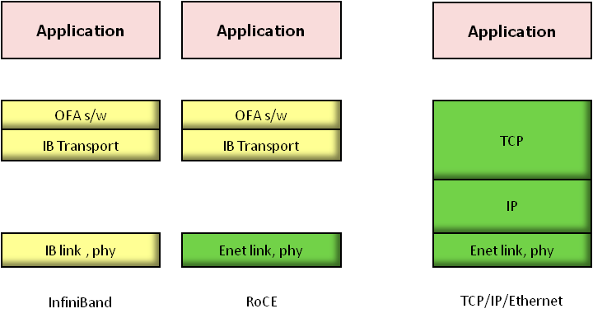
RoCE

Slide 31
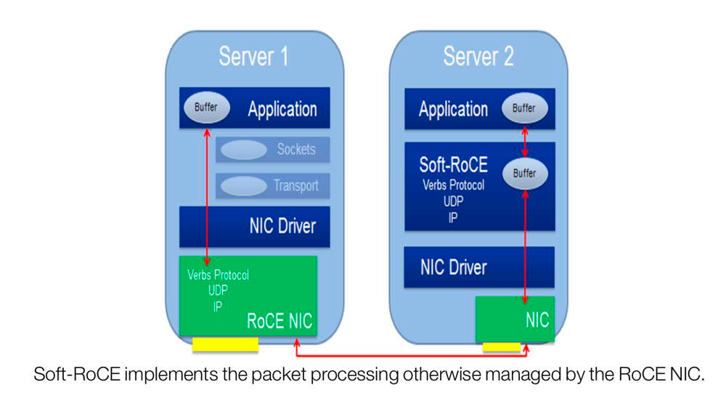

Slide 32
Soft-RoCE

Slide 33
iWARP

Slide 34
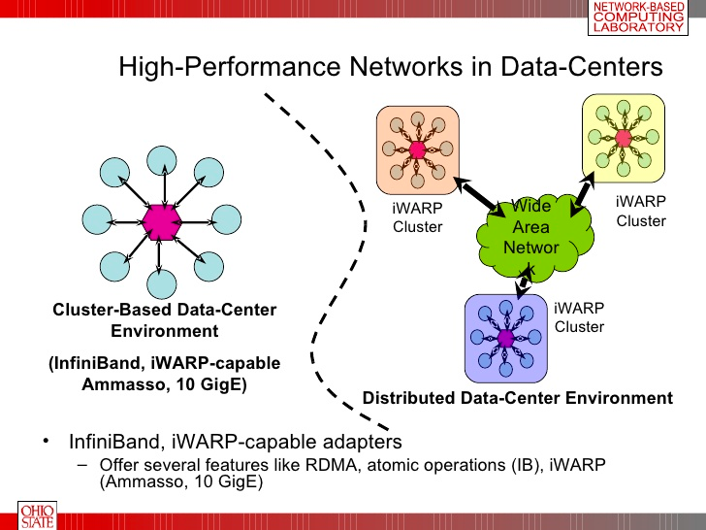
iWARP - Internet Wide Area RDMA Protocol

Slide 35
Software RDMA Drivers
Softiwarp
  www.zurich.ibm.com/sys/rdma
  open source kernel module that implements iWARP protocols on top of ordinary kernel TCP sockets
  interoperates with hardware iWARP at other end of wire
Soft RoCE
  www.systemfabricworks.com/downloads/roce
  open source IB transport and network layers in software over ordinary Ethernet
  interoperates with hardware RoCE at other end of wire

Slide 36
Means that…
Clusters can be made from geographically disparate nodes
Run smoothly over the Internet (TCP/IP)
Mobile/Wireless clusters can cluster-up together with enormously powerful HPC clusters
World wide multi-million node clusters, each its own Internet or cloud

Slide 37
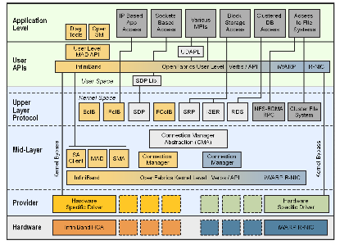

OFED - OpenFabrics Enterprise Distribution
Available for Linux and Windows. Includes kernel-level drivers, channel-oriented RDMA and send/receive ops, kernel bypass, kernel and user-level API, MPI, sockets data exchange(RDS, SDP), NAS and SAN storage (iSER, NFS-RDMA, SRP) and File Systems/DB systems. RDMA network and fabric technologies for: legacy 10 GB Ethernet, iWARP for Ethernet, RoCE, and 10/20/40 Gigabit InfiniBand.
Notes:
Open Source software provided by the OpenFabrics Alliance. Provides legacy services over InfiniBand through APIs to Upper Layer Protocol (ULP) (annotated by yellow marker) kernel modules.
Not what we want. The ULP route is not programable.

Slide 38
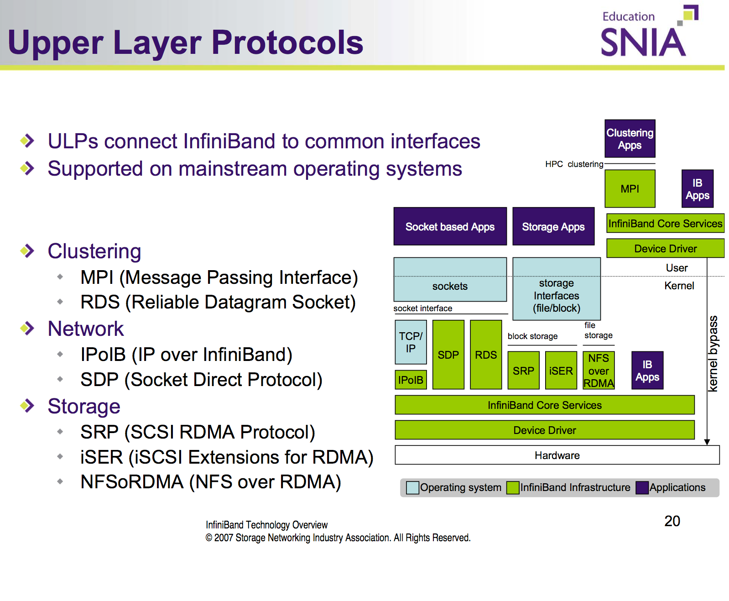

Slide 39
Legacy services through Upper Level Protocol kernel modules.
Not Programmable
Notes:
Following the previous slide, the left hand side shows applications interfaced through APIs to Upper Layer Protocols (ULPs) to legacy service emulation. Not Programmable!

Slide 40
Programmability with RDMA verbs (or newer PSM)
We’ll see how any agreed upon networking code loaded on all the nodes becomes a so-called, protocol.
Here we program RDMA verbs.

Slide 41
Programmable

Slide 42
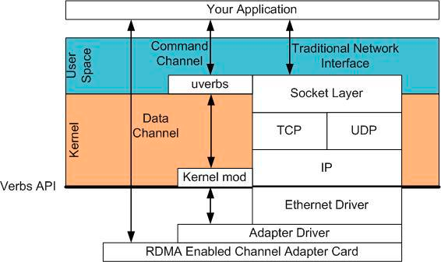
Verbs
Notes:
Here we see the comparison between inflexible protocols in the kernel (previous slide on the right) and programmable RDMA verbs. Still a tricky art without a yet-to-be developed verbs compiler. Not trivial, but the payoff is enormous since the verb-programming code is application code, could be incorporated with the app.

Slide 43
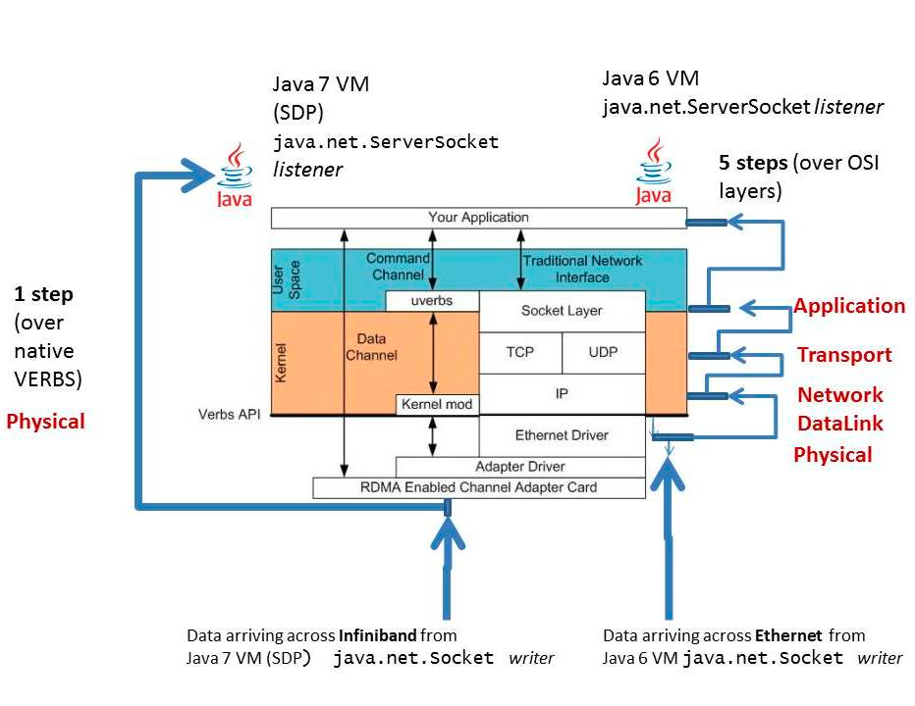
Java 7 VM over verbs
Notes:
Here’s a fine example of what we’re striving for languages and services over verbs (or newer technology, PSM etc.). This is Java 7. We want additional concurrent languages like GoLang, Erlang/Elixir, etc. over verbs.

Slide 44
Custom Networking Schemes
Network management, switching and routing, programmed verbs or PSM all provided by the devices as user-space loadable software.
Freedom from rigid protocols is the logical next step.

Slide 45

and began writing their own protocols

Slide 46
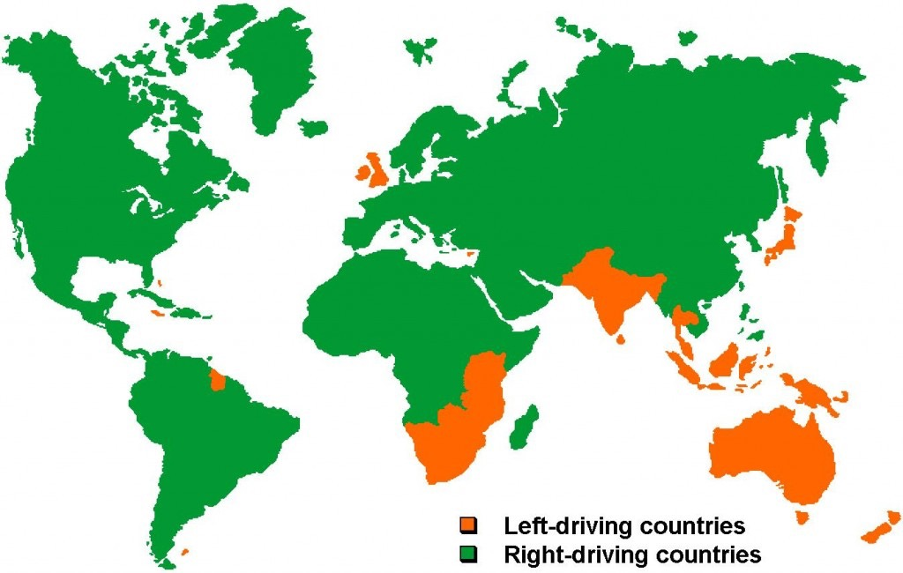
Protocols, essential where needed

Slide 47
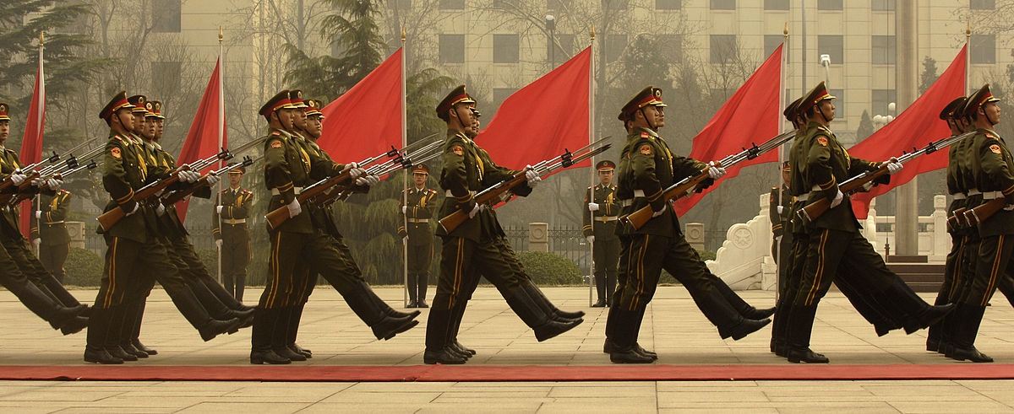
Imagine if Software had to be Protocol Conformant
but a hindrance where not needed

Slide 48
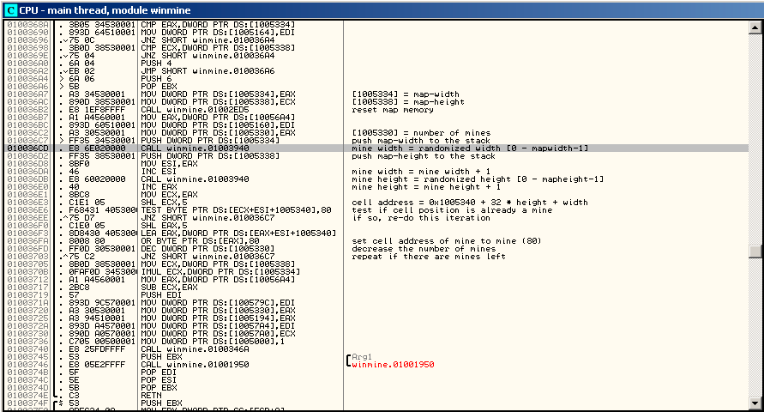
Painstaking, Meticulous
Only one language
Ran on only one type of machine
Network protocols are like software before compilers

Slide 49
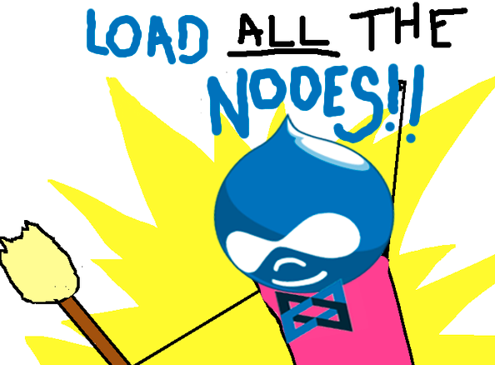
Talk about protocols
Loadable networking code is application code
Want to switch or update the so-called, eh, protocol?
Just

Slide 50
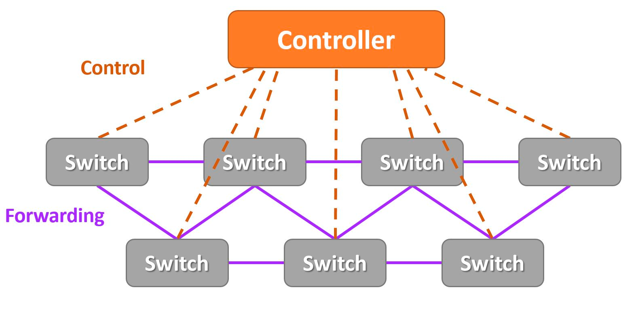
pushing code instead of data onto all the nodes
Like an
SDN
to run alternate network schemes

Slide 51
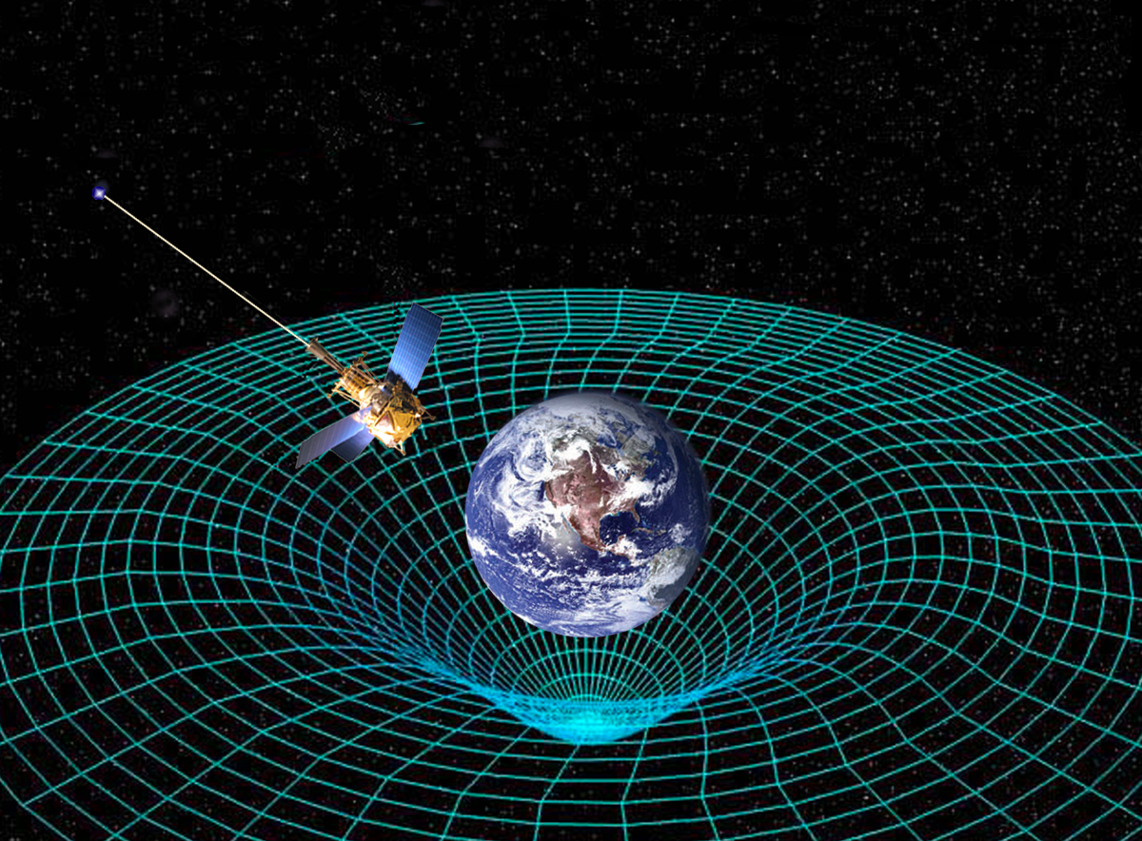
Escape the protocol‑bound gravitational field

Slide 52

If programming RDMA verbs is so
then why is hardly anyone doing it?
Because it ain’t easy yet. That it’s programmable is remarkable in itself, but it's still like assembly coding. We need a compiler (on the checklist)

Slide 53
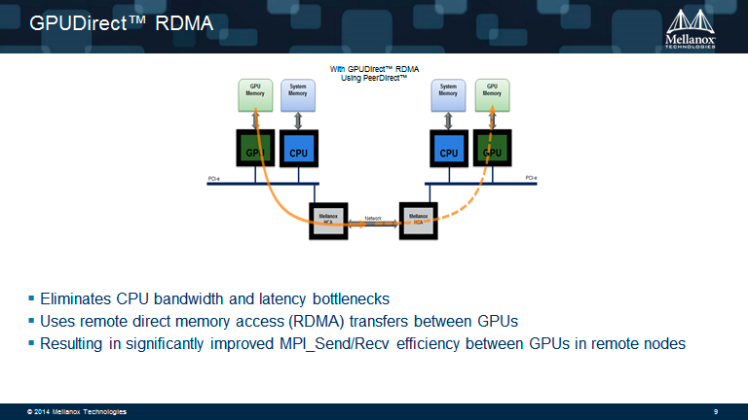
Upcoming RDMA technologies
RDMA transfers between GPUs

Slide 54
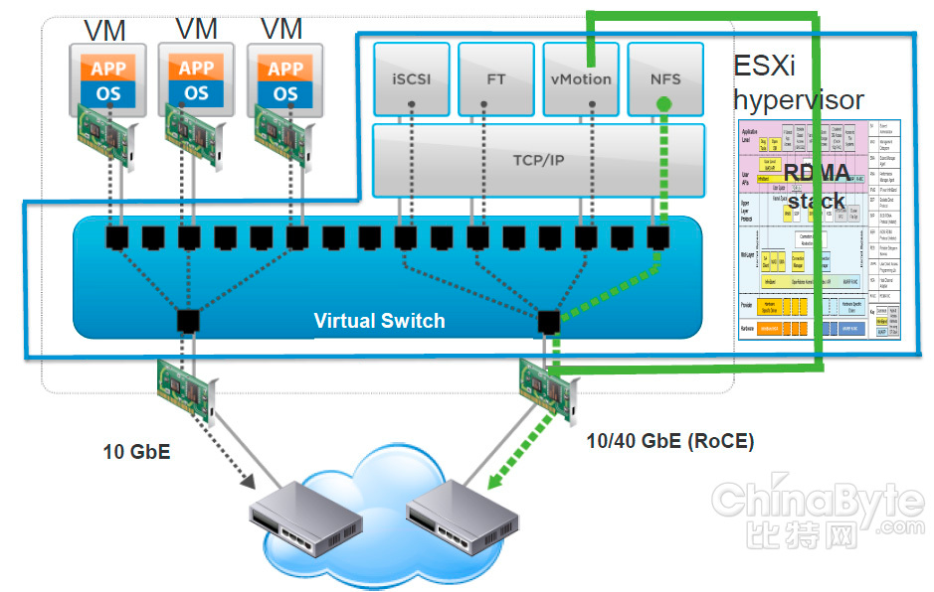
Upcoming RDMA technologies
Virtualized RDMA

Slide 55
A few Use Cases
Internet of Things - infinitely more flexible
Realtime statistical data mining or data mashing which produce visual outputs in a close region, like say, a visual realtime picture of crowd behavior patterns in a shopping mall or train station.
Apps which today have to be manually installed, could be seeded and run. No need for web sites, uploads to the Internet, fixed IP addresses, run as easily as a local GUI app.
Cooperative coding in realtime. Developers/users hacking together on the same running app platform.

Slide 56
Such a Simple Conceptual Model
must be easy to implement

Slide 57

Sorry, not quite
There are Formidable Challenges,
But…

Slide 58

Nothing we don’t know how to do

Slide 59
Challenges we can meet
Partial list
On-the-fly clustering of mobile devices
On-the-fly D2D clusters of close proximity cars.
Wireless InfiniBand Fabric Manager
Wireless InfiniBand chips. SoftROCE over Wi-Fi for the interim
Android virtualized RDMA or container D2D apps
Networking Meta Language or DSL over RDMA verbs

Slide 60
Partial list of challenges, cont’d
Lacking external switching devices, switching and routing have to be done by the devices themselves.
Seeding - bootstrapping the app/cluster
  Isolation between overlapping app/clusters
  Mixing and merging overlapping app/clusters
Member registration, volatile resource allocation manager
etc., etc….

Slide 61
Take note…
As opposed to present-day networking, in a protocol-free, all-software (or nearly all-software) realm, not all problems have to be solved in advance. The challenge is less in doing than it is in enabling to be done. The consortium’s challenge is to build the so-called launchpad, the necessary prerequisites for the developers to begin their work. From there, it becomes an evolutionary process.

Slide 62
Volleyball Fabric Manager
Players come and go but the ball stays in the air
Redundancy and distributed juggling keeps the cluster app in the air as devices join and leave

Slide 63
Resources
Introduction to InfiniBand
InfiniBand Technology Overview
vVerbs A Paravirtual Subsystem for RDMA

